Slide 1
CPU Scheduling
Dr. Manmath N. Sahoo
Dept. of CSE, NIT Rourkela

Slide 2
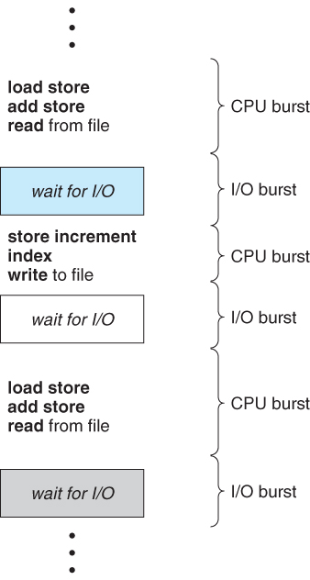
CPU-I/O Burst Cycle
CPU–I/O Burst Cycle – Process execution consists of a cycle of CPU execution and I/O wait.
CPU burst is length of time process needs to use CPU before it next makes a I/O request.
I/O burst is the length of time process spends waiting for I/O to complete.

Slide 3
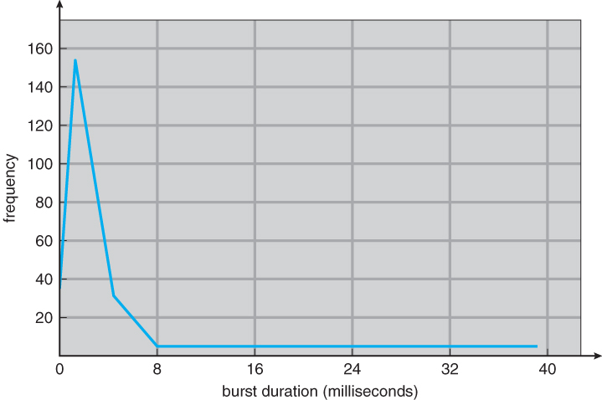
Histogram of CPU-burst Times
Typical CPU burst distribution

Slide 4
CPU Scheduler
Allocates CPU to one of processes that are ready to execute (in ready queue)
CPU scheduling decisions may take place when a process:
Switches from running to waiting state (e.g. I/O request)
Terminates
Switches from waiting to ready (e.g. I/O completion)
Switches from running to ready state (e.g. priority based interruption)

Slide 5
Dispatcher
Dispatcher gives control of the CPU to the process selected by the short-term scheduler; this involves:
switching context
switching to user mode (if CPU was executing the previous process in kernel mode and preempted)
jumping to the proper location in the user program to restart that program (i.e., last action is to set program counter)
Dispatch latency – time it takes for the dispatcher to switch between processes and start new one running

Slide 6
Scheduling Criteria
CPU utilization: i.e. CPU usage – want to maximize
Throughput: number of processes that complete their execution per time unit – want to maximize
Turnaround time: amount of time to execute a particular process – want to minimize
Waiting time: amount of time a process has been waiting in the ready queue – want to minimize
Response time: amount of time it takes from when a job was submitted until it initiates its first response (output) – want to minimize

Slide 7
First-Come, First-Served Scheduling
Schedule: order of arrival of process in ready queue
Example: Process Burst Time
P₁ 24
P₂ 3
P₃ 3
Suppose that the processes arrive in the order: P₁ , P₂ , P₃. The Gantt Chart for the schedule is:
Waiting time for P₁ = 0; P₂ = 24; P₃ = 27
Average waiting time: (0 + 24 + 27)/3 = 17
P₁
P₂
P₃
0
24
27
30

Slide 8
FCFS Scheduling
Suppose that the processes arrive in the order P₂ , P₃ , P₁ .
The Gantt chart for the schedule is:
Waiting time for P₁ = 6; P₂ = 0; P₃ = 3
Average waiting time: (6 + 0 + 3)/3 = 3
P₂
P₃
P₁
0
3
6
30

Slide 9
FCFS Scheduling
Simple to implement by FIFO queue.
Code is easy to write and understand
Average waiting time is not minimal
Not suitable for time-sharing systems
Convoy effect: short I/O intensive processes behind long CPU intensive process
NOTE: FCFS Scheduling is non-preemptive

Slide 10
Large CPU bound process
C₁ (1200ms): 1000ms computation + 200ms I/O
200cpu – 50io – 200cpu – 50io – 200cpu – 50io – 200cpu – 50io – 200cpu
Small I/O bound processes
I₁, I₂, …, I₁₀
(8.5ms): 2.5ms computation + 8ms I/O
0.5cpu – 2io – 0.5cpu – 2io – 0.5cpu – 2io – 0.5cpu – 2io – 0.5cpu
May lead to less CPU utilization and I/O utilization → Convoy effect

Slide 11
Shortest-Job-First (SJF) Scheduling
Schedule: order of the CPU burst of the processes.
Two schemes:
Non-Preemptive SJF / Shortest Job Next (SJN)
once CPU given to the process it cannot be preempted until completes its CPU burst.
Preemptive SJF / Shortest Remaining Time First (SRTF)
if a new process arrives with CPU burst length less than remaining time of current executing process, preempt.

Slide 12
Non-Preemptive SJF (SJN)
Process Arrival Time Burst Time
P₁ 0 7
P₂ 2 4
P₃ 4 1
P₄ 5 4
Gantt Chart:
Average waiting time = (0 + 6 + 3 + 7)/4 = 4
P₁
P₃
P₂
P₄
0
3
7
8
12
16

Slide 13
Preemptive SJF (SRTF)
Process Arrival Time Burst Time
P₁ 0 7
P₂ 2 4
P₃ 4 1
P₄ 5 4
Gantt Chart:
Average waiting time = (9 + 1 + 0 +2)/4 = 3
P₁
P₂
P₃
P₂
P₄
P₁
0
2
4
5
7
11
16

Slide 14
Example
Process Arrival Time Burst Time
P1 0 16
P2 2 8
P3 4 12
P4 6 2
P5 8 4
Draw Gantt chat and find the average waiting time in each of the following cases:
SRTF Scheduling
SJN Scheduling
FCFS Scheduling

Slide 15
Answer to Example
Process Arrival Time Burst Time
P1 0 16
P2 2 8
P3 4 12
P4 6 2
P5 8 4
SRTF
Average waiting time = (26+6+12+0+0)/5
= 8.8
P1 | P2 | P2 | P4 | P2 | P5 | P3 | P1
0 | 2 | 4 | 6 | 8 | 12 | 16 | 28 | 42

Slide 16
Answer to Example
Process Arrival Time Burst Time
P1 0 16
P2 2 8
P3 4 12
P4 6 2
P5 8 4
SJN
Average waiting time = (0+20+26+10+10)/5
= 13.2
P1 | P4 | P5 | P2 | P3
0 | 16 | 18 | 22 | 30 | 42

Slide 17
Answer to Example
Process Arrival Time Burst Time
P1 0 16
P2 2 8
P3 4 12
P4 6 2
P5 8 4
FCFS
Average waiting time = (0+14+20+30+30)/5
= 18.8
P1 | P2 | P3 | P4 | P5
0 | 16 | 24 | 36 | 38 | 42

Slide 18
Answer to Example
Scheduling Algorithm | Average Waiting Time
FCFS | 18.8
SJN | 13.2
SRTF | 8.8

Slide 19
Shortest Job First
SRTF is Optimal: Minimum Average waiting time.
Longer processes may be starved.
Difficult to know the CPU burst of processes before their execution

Slide 20
Round Robin (RR) Scheduling
Each process gets a time quantum, usually 10-100 milliseconds.
After this time has elapsed, the process is preempted and added to the end of the ready queue.
If there are n processes in the ready queue and the time quantum is q, then each process gets 1/n of the CPU time.
No process waits more than (n-1)q time units.

Slide 21
Example: RR with q= 20
Process Burst Time
P₁ 53
P₂ 17
P₃ 68
P₄ 24
The Gantt chart is:
Typically, higher average turnaround than SJF, but better response.
P₁
P₂
P₃
P₄
P₁
P₃
P₄
P₁
P₃
P₃
0
20
37
57
77
97
117
121
134
154
162

Slide 22
Round Robin (RR) Scheduling
FCFS + Preemption = RR
Performance
q large ⇒ behaves similar to FCFS
q small ⇒ more context switch overhead

Slide 23
Modified RR Scheduling
Based on variable time quantum
A preempted process, on its next turn will use an increased time quantum
RR Scheduling
P₁: 300ms, q=20ms, time per context switch=2ms
#of preemptions due to this process = 14
Preemption overhead = 28ms

Slide 24
Modified RR Scheduling
Modified RR Scheduling – q is doubled in next turn.
P₁: 300ms, q=20ms (initial)
#of preemptions due to this process = 3. (20+40+80+160=300)
Preemption overhead = 6ms

Slide 25
Priority Scheduling
A priority number (integer) is associated with each process and the CPU is allocated to the process with the highest priority
Some schemes use smallest integer ≡ highest priority.
SJF is effectively priority scheduling where priority is defined on next CPU burst time.
FCFS is effectively priority scheduling where priority is defined on arrival time.

Slide 26
Priority Scheduling
Problem: Starvation – low priority processes may never execute.
Solution: Aging – as time progresses increase the priority of the process.
e.g. in every 10ms increase the priority of process by 1

Slide 27
Highest Response Ratio Next (HRRN) Scheduling
It gives priority to shorter jobs similar to SJN
Implements Aging implicitly
Non-preemptive dynamic priority based algorithm with initial priority 1
p=1+(wait time/burst time)

Slide 28
Highest Response Ratio Next (HRRN) Scheduling
Process Arrival Time Burst Time
P1 0 3
P2 2 6
P3 4 4
P4 6 5
P5 8 2
P1 | P2 | P3 | P5 | P4
0 | 3 | 9 | 13 | 15 | 20

Slide 29
Multi level Queue Scheduling
Ready queue is partitioned into separate queues.
Each queue holds a particular category of processes.
Each queue can implement whatever scheduling algorithm is most appropriate for that type of processes.

Slide 30
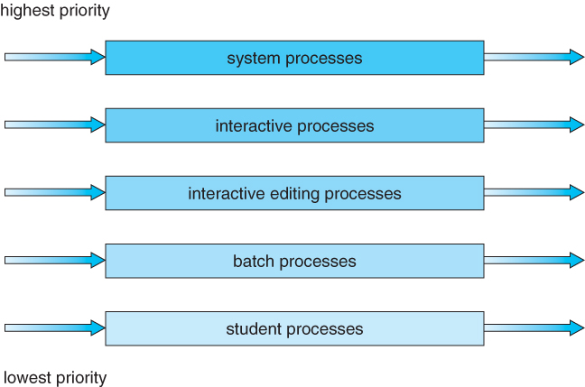
Multi level Queue Scheduling

Slide 31
Multilevel Queue Scheduling
Scheduling must be done between the queues.
Priority scheduling; But possibility of starvation.
Time slice – each queue gets a certain amount of CPU time which it can schedule amongst its processes;

Slide 32
Multilevel Queue Scheduling
Objectives:
to optimize turnaround time.
To minimize response time (to make a system feel responsive to interactive users).
THE CRUX:
HOW TO SCHEDULE WITHOUT PERFECT KNOWLEDGE?
How can we design a scheduler that both minimizes response time for interactive jobs while also minimizing turnaround time without a priori knowledge of job length?
Notes:
-SJF can optimize turnaround time, however, it is not possible to know the CPU burst time of the processes prior to their execution.
-Round Robin reduce response time but are terrible for turnaround time.

Slide 33
Multilevel Feedback Queue Scheduling -Basic Rules
>1 number of queues, each assigned a different priority level
Processes are executed from top priority queue to low priority queue.
Rule 1: If Priority(A) > Priority(B), A runs (B doesn’t).
Rule 2: If Priority(A) = Priority(B), A & B run in RR.

Slide 34
MLFQ: Basic Rules
MLFQ varies the priority (dynamic) of a job based on its observed behavior.
If a process repeatedly relinquishes the CPU, MLFQ will keep its priority high.
If a job uses the CPU intensively for long periods of time, MLFQ will reduce its priority.

Slide 35
MLFQ Example

Slide 36
MLFQ Priority Adjustment: Attempt#1
Rule 3: When a job enters the system, it is placed at the highest priority (the topmost queue).
Rule 4a: If a job uses up an entire time slice while running, its priority is reduced (i.e., it moves down one queue).
Rule 4b: If a job gives up the CPU before the time slice is up, it stays at the same priority level.

Slide 37
Example 1: A Single Long-Running Job

Slide 38
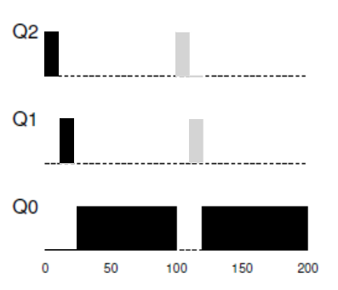
Example 2: Along Came A Short Job (20ms) at 100ms
MLFQ approximates SJF

Slide 39
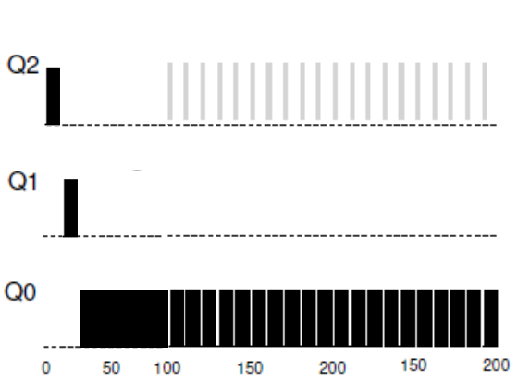
Example 3: What About I/O?
An interactive job B needs the CPU only for 1ms before performing an I/O of 9ms.

Slide 40
Problems With Current MLFQ
Starvation to long jobs.
A smart user could rewrite their program to game the scheduler.
A process may change its behavior over time - from CPU bound to a phase of interactivity.

Slide 41
Attempt #2: The Priority Boost
guarantees that CPU-bound jobs will make some progress (even if it is not much).
Rule 5: After some time period S, move all the jobs in the system to the topmost queue.

Slide 42
Attempt #2: The Priority Boost
interactive jobs need CPU only for 5ms before performing an I/O of 5ms.
(a) Without Priority Boost
(b) With Priority Boost in every 50ms

Slide 43
Attempt #3: Better Accounting
To prevent gaming of the scheduler, Rules 4a and 4b are rewritten to the following single rule:
Rule 4: Once a job uses up its time quantum at a given level (regardless of how many times it has given up the CPU), its priority is reduced (i.e., it moves down one queue).

Slide 44
Effect of anti-Gaming rule
(a) Without anti-Gaming rule
(b) With anti-Gaming rule

Slide 45
Highest Response Ratio Next (HRRN) Scheduling
It gives priority to shorter jobs similar to SJN
Implements Aging implicitly
Non-preemptive dynamic priority based algorithm with initial priority 1
p=1+(wait time/burst time)

Slide 46
Highest Response Ratio Next (HRRN) Scheduling
Process Arrival Time Burst Time
P1 0 3
P2 2 6
P3 4 4
P4 6 5
P5 8 2
P1 | P2 | P3 | P5 | P4
0 | 3 | 9 | 13 | 15 | 20

Slide 47
Uniprocessor vs Multiprocessor
Single CPU with Cache
Two CPUs with Caches

Slide 48
Multiprocessor Scheduling
Single Queue Multiprocessor Scheduling
Multi Queue Multiprocessor Scheduling

Slide 49
SQMS
LTS loads all jobs to the common ready queue.
However, there are multiple STSs.
Simple to implement
Synchronization overhead (lock overhead)
Doesn’t preserve Cache affinity

Slide 50
SQMS
RR Scheduling on 04 CPUs:
processes bounce from CPU to CPU.
Solution – SQMS must adopt some affinity mechanism (requires migration)

Slide 51
SQMS
Schedule with migration

Slide 52
MQMS
2 Processors: CPU0, CPU1.
A goes to CPU0
B goes to CPU1
C goes to CPU0
D goes to CPU1

Slide 53
MQMS
Synchronization overhead (lock overhead)
Preserves Cache affinity
Load imbalance

Slide 54
MQMS
Load imbalance
C finishes
A finishes

Slide 55
MQMS
Solution to load imbalance -> migration
Solution: Simply move one of B or D to CPU 0

Slide 56
MQMS
A single migration doesn’t help.
Solution: In every 40ms migrate one job.

